Slide 1
San Marcos airport expansion project
Prepared for the Texas Department of Transportation

Slide 2
Geo-Air Consulting Team
Peter Binion
Project Manager
GIS Analyst
Marcus Pacheco
GIS Analyst
Michael Tebo
Web Master
GIS Analyst
Bradford Williams
GIS Analyst

Slide 3
In Brief
Texas Department of Transportation (TXDOT) tasked Geo-Air Consulting with a planning study for expanding two runways at the San Marcos Airport.
Controlled Compatibility Land Use reclassification of existing land use/parcel data.
Obstruction penetration analysis performed on imaginary surfaces as defined by Federal Aviation Administration (FAA).
Solution length for runway 17-35 and 13-31.

Slide 4
Literature Review
Land Use
Texas Airport Zoning Act
City of Houston Amendments to Regulations for Airport Compatible Land Use for Bush Intercontinental, Hobby and Ellington Airports.
Airport Cooperative Research Program
Hazards Zoning
FAA Circular AC 150/5300–13
List Standards for Airport and Runway Design
FAA Title 14 CRF Part 77
Preservation of navigable airspace

Slide 5
Data
Controlled Compatibility Land Use
Imaginary Surfaces
Polygon Construction
Penetration Analysis

Slide 6
Data-Land Use
City of San Marcos (COSM)
Hays and Caldwell County Parcel Shapefile
Existing Land Use Shapefile
Future Land Use Shapefile
TXDOT
Remotely Sensed Image – July 2012
Capital Area Council of Governments (CAPCOG)
Land Use Shapefile
Parcel Shaefile

Slide 7
Data-Imaginary Surfaces Polygon Construction
TXDOT
Source data in the form of shapefiles for airport components and 18B designed imaginary surfaces.
OBSTRUCTIONID SURFACE Shapefile
RUNWAYS Shapefile
FENCE Shapefile

Slide 8
Data-Imaginary Surfaces Penetration Analysis
United States Geological Survey (USGS)
Digital Elevation Model Quadrant
TXDOT
OBSTACLE Shapefile
Geo-Air Consulting
Imaginary surface constructed polygons

Slide 9
Methods
Controlled Compatibility Land Use
Imaginary Surfaces
Polygon Construction
Penetration Analysis

Slide 10
Controlled Compatibility Land Use
Analyzed CAPCOG Land Use and Parcel Shapefiles.
Validated accuracy of data with a cross check of COSM land use and parcel data.
Created “Controlled” area
Buffered runway centerline
Clipped CAPCOG Land Use Shapefile and TXDOT aerial image.
Reclassified Land Use types
Grouped values

Slide 11
Polygon Construction
Created polygon shapefiles from TXDOT shapefiles.
Edited vertices to correct dimensions.
This procedure provided all needed imaginary surfaces for analysis.
Completed polygons moved into proper spatial location by measurement.

Slide 12
Penetration Analysis

Slide 13
Results
Controlled Compatibility Land Use
Imaginary Surfaces
Polygon Construction
Penetration Analysis

Slide 14
Land Use Findings
Identified current land use at parcel level for “controlled” area.
Land Uses | Count | Percentage
Residential | 7087 | 66%
Vacant | 1338 | 12%
Agricultural | 906 | 8%
Public | 731 | 7%
Commercial Industrial | 606 76 | 6% 1%
Total | 10744 | 100%

Slide 15
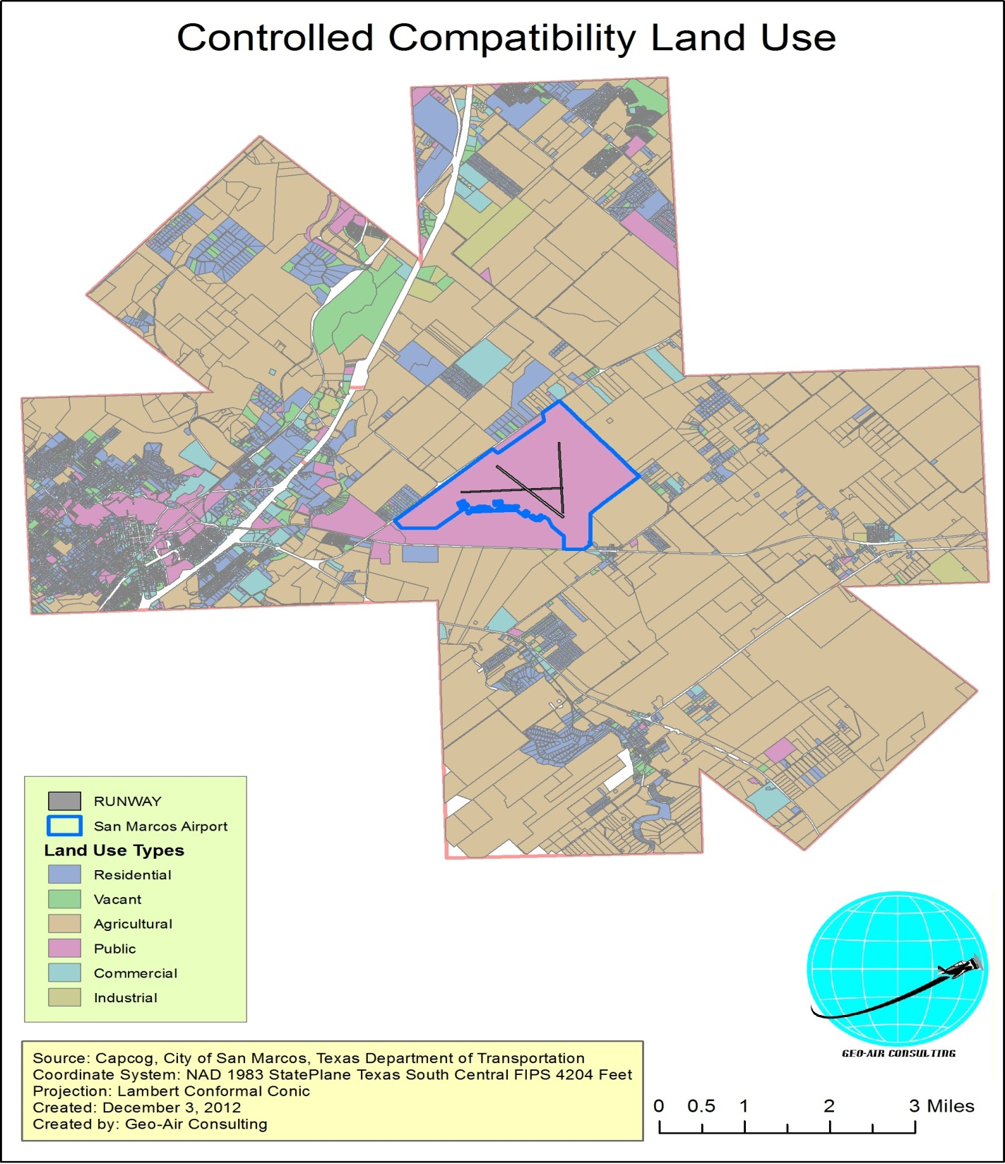

Slide 16
Imaginary Surfaces Findings 17-35
780 foot extension on 35 end of runway 17-35 advised. (10 Penetrations)
780 foot extension on 17 end of runway 17-35 NOT advised. (950 Penetrations)
RW35 34:1 Penetrations
FID | X | Y | PEN IN FT | NAME
6 | -97.857638 | 29.881296 | 48.33 | TREE
5 | -97.857618 | 29.88128 | 42.54 | TREE
4 | -97.856747 | 29.880146 | 28.56 | TREE
11 | -97.858669 | 29.884897 | 26.88 | PRIMARY ROAD
10 | -97.858431 | 29.884777 | 10.42 | PRIMARY ROAD
9 | -97.858386 | 29.884753 | 10.06 | PRIMARY ROAD
12 | -97.858145 | 29.884631 | 8.14 | PRIMARY ROAD
13 | -97.857869 | 29.884484 | 6.37 | PRIMARY ROAD
1 | -97.858675 | 29.883803 | 4.67 | TREE
8 | -97.857582 | 29.884341 | 4.19 | PRIMARY ROAD

Slide 17
Imaginary Surfaces Findings 13-31
Solution length of 400 feet advised.
200 penetrations of 50:1 approach surface. (All Trees)
Runway Safety Area & Runway Protection Zone penetrated airport boundary. (Acquire adjacent land)
Solution length of 200 feet.
97 penetrations of 50:1 approach surface. (All Trees)
Runway Protection Zone penetrated airport boundary. (Acquire adjacent land)

Slide 18
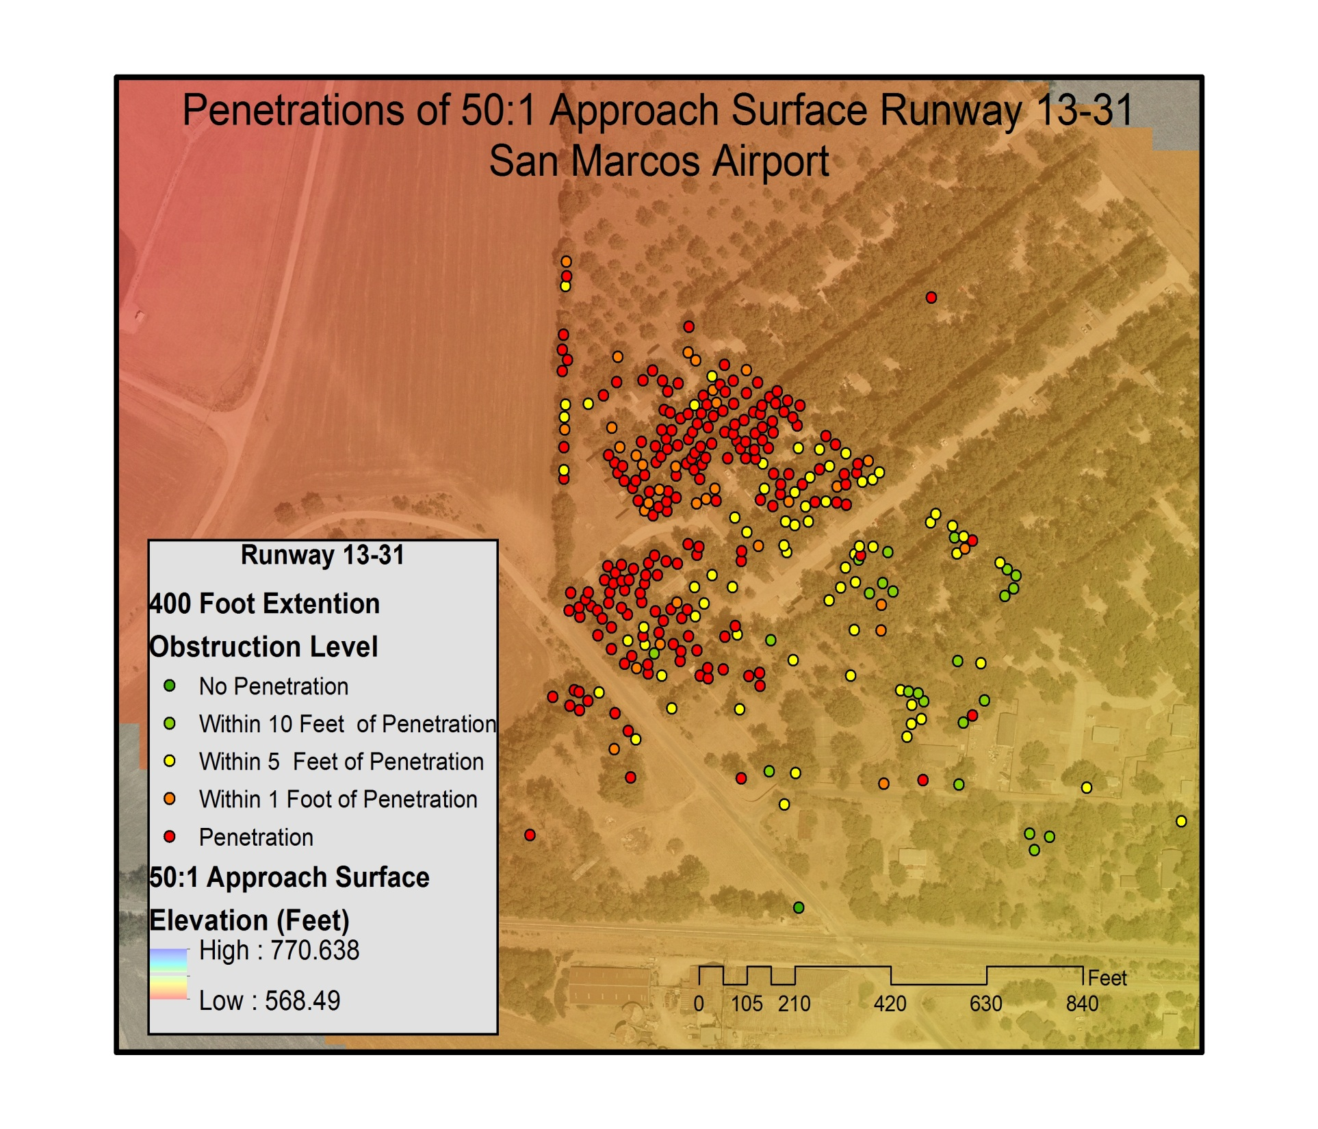

Slide 19
Obstruction Summary

Slide 20
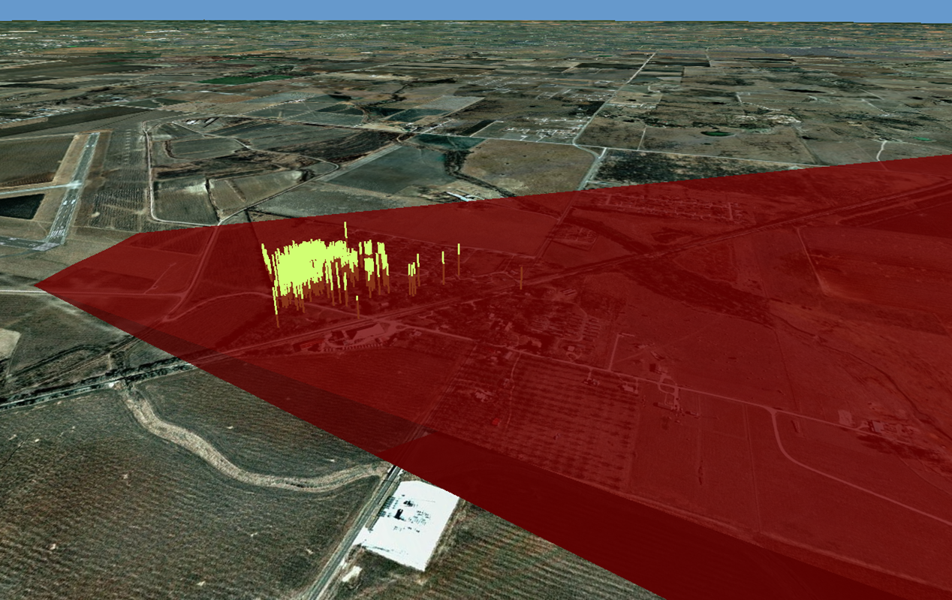
3D Modeling

Slide 21
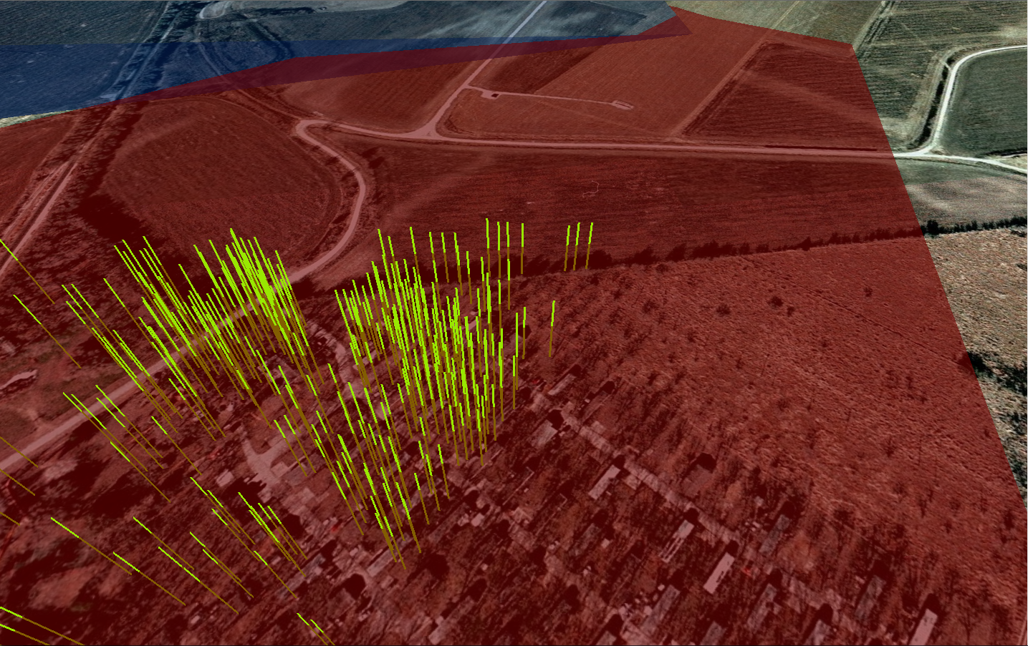
3D Modeling (Continued)

Slide 22
Conclusion
Land Use in controlled area reclassified. All areas accurately grouped for zoning.
Imaginary surfaces modeled and penetration analysis matrix complete.
Solution length for 35 end of 17-35 runway.
780 feet
Solution length for 31 end of 13-31 runway.
400 feet

Slide 23
Special Thanks
Dr. Yongmei Lu
Mr. Ryan Schuermann
Mr. Daniel Benson

Slide 24
Questions or Comments?

